Slide 1
Patient Discharge Summaries
Talha Ahmed
018960110
Generating Patient Discharge Summaries using distilGPT2

Slide 2

Problem Statement
Clinical documentation is time-intensive yet crucial.
Discharge summaries summarize a patient’s hospital stay.
Manual writing causes: High workload, inconsistent quality, and delays.
Goal: Automate discharge summary generation using Generative AI.

Slide 3
01
Project Overview

Slide 4
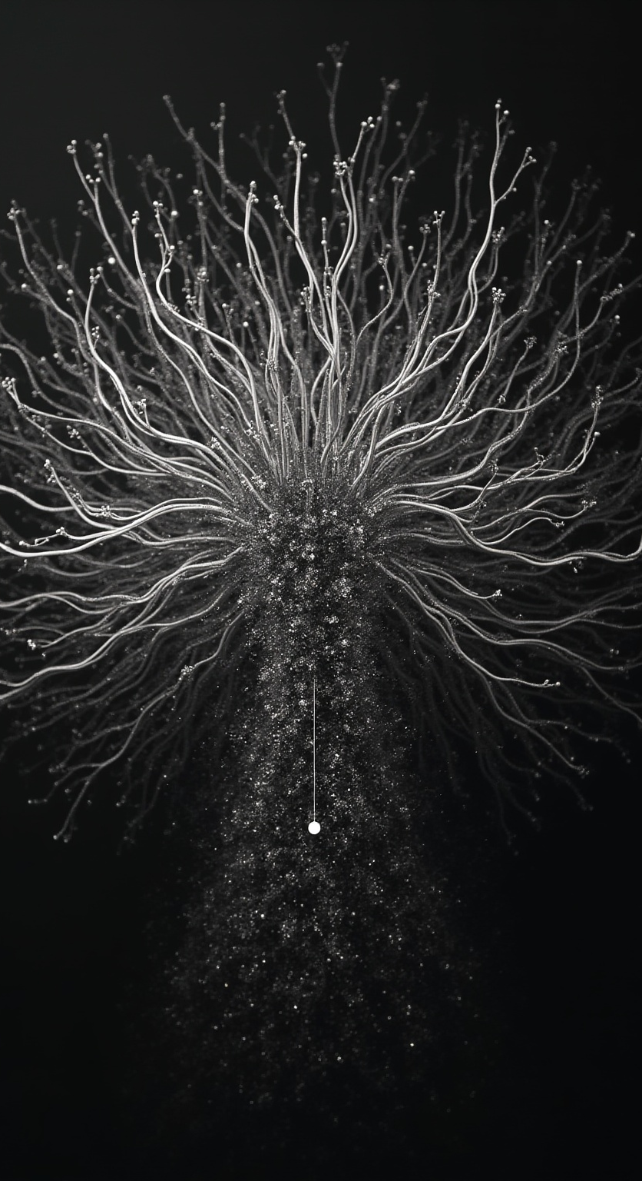
Objectives
Build a Transformer-based model using distilGPT2.
Input: Structured patient data.
Output: Human-like discharge summaries.
Aims: Reduce documentation time, standardize summaries, and demonstrate NLP’s potential in healthcare.

Slide 5
Dataset Description and Preprocessing
Dataset: BHC-MIMIC-IV Summary (from Kaggle).
Based on the MIMIC-IV clinical database.
Each record: Input → Patient info; Target → Human-written summary.
Input length: 400–800 tokens; Output: 700–1000 tokens.
Partitioning: Split into 70% train, 15% validation, 15% test; converted to Hugging Face dataset format.

Slide 6
02
Model Development and Evaluation

Slide 7
Training Methodology and Details
Model: distilGPT2 (Autoregressive Transformer).
Configuration: Token limit 1024, AdamW optimizer, LR=1e-4, batch size=2, epochs=6.
Trained using Hugging Face Seq2SeqTrainer with GPU acceleration.

Slide 8
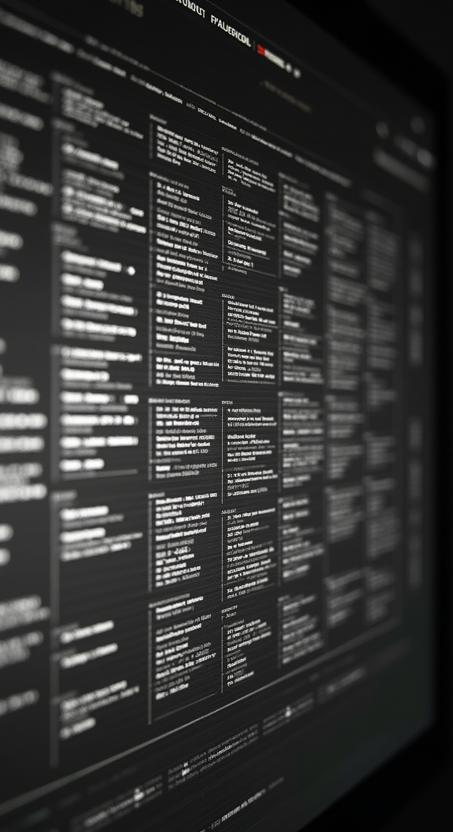
Evaluation Metrics and Interpretation
ROUGE-1: 0.2626
ROUGE-2: 0.0683
ROUGE-L: 0.1147
ROUGE-Lsum: 0.162
BERTScore (F1): 0.8109
ROUGE → Moderate lexical overlap.
BERTScore → High semantic similarity to reference summaries.

Slide 9
Results & Insights
Input: Patient admitted with cough, wheezing, shortness of breath.
Generated Summary: Patient treated for viral bronchitis; discharged stable.
Observations: Coherent, clinically logical, with minor generalization issues.
Challenges: Noisy text, token limitation, adapting general model to clinical data.
Insights: Model learned clinical structure effectively; demonstrated automation potential.

Slide 10
Conclusions
Use larger models (GPT-2 Medium, T5-base).
Add medical embeddings (BioBERT, ClinicalBERT).
Include BLEU, METEOR, human evaluation.

Slide 11
THANK YOU
2XXX

